Slide 1

Industrial Safety and Maintenance Monitoring System
Group members
Kuheli Das (22106003)
Nishat Khan (22106021)
Hrishikesh Kharkar(22106002)
Haniya Akhtar(22106130)
Project Guide
Prof. Shraddha Dalvi

Slide 2
Introduction
The Industrial Safety and Maintenance Monitoring System is a centralized platform designed to streamline and optimize the maintenance processes of industrial machinery.
This project aims to enhance the efficiency of maintenance workflows, reduce downtime, and improve overall equipment performance by integrating technology and data-driven solutions.

Slide 3
Literature of the existing system
Sr.No | Year | Techniques used | Performance metrics | Suggestions
[1] | 2017 | Time Series Forecasting Techniques | downtime reduction , mean time between failures | Real-Time Data Processing
[2] | 2014 | Traditional Condition Monitoring Techniques | F1-score | Feature Engineering
[3] | 2019 | Data driven ml techniques | F1-score | Computational cost consideration
[4] | 2021 | Oil Contamination Analysis | Reduction in Catastrophic Breakdowns | Justification for Oil Contamination
[5] | 2012 | Time-Based Maintenance | F1-score,Accuracy,Precision | Cost-Benefit Analysis
Notes:
https://ieeexplore.ieee.org/abstract/document/8342870
https://www.researchgate.net/profile/Alaa-Jaber/publication/298786843_The_State_of_the_Art_in_Research_into_the_Condition_Monitoring_of_Industrial_Machinery/links/5b238c3f0f7e9b0e3748b770/The-State-of-the-Art-in-Research-into-the-Condition-Monitoring-of-Industrial-Machinery.pdf
https://ieeexplore.ieee.org/abstract/document/8707108
Mohan, T. Roosefert, J. Preetha Roselyn, R. Annie Uthra, D. Devaraj, and K. Umachandran. "Intelligent machine learning based total productive maintenance approach for achieving zero downtime in industrial machinery." Computers & Industrial Engineering 157 (2021): 107267.
https://www.sciencedirect.com/science/article/abs/pii/S0360835212000484

Slide 4
Limitations of Existing System
1. Lack of updation of real time data in a dynamic matter.
2. Overfitting & Poor Generalization: Some models (like Random Forest) may overfit to historical data and struggle with unseen conditions.
3.Ignoring Feature Importance & Sensor Often use all available sensor data without prioritizing the most relevant features, leading to noisy predictions.

Slide 5
Problem Statement
The main objective is to develop a centralized maintenance platform that integrates advanced technology and real-time monitoring to enhance equipment performance, improve efficiency, and reduce maintenance costs, thereby revolutionizing maintenance management in industrial settings.

Slide 6
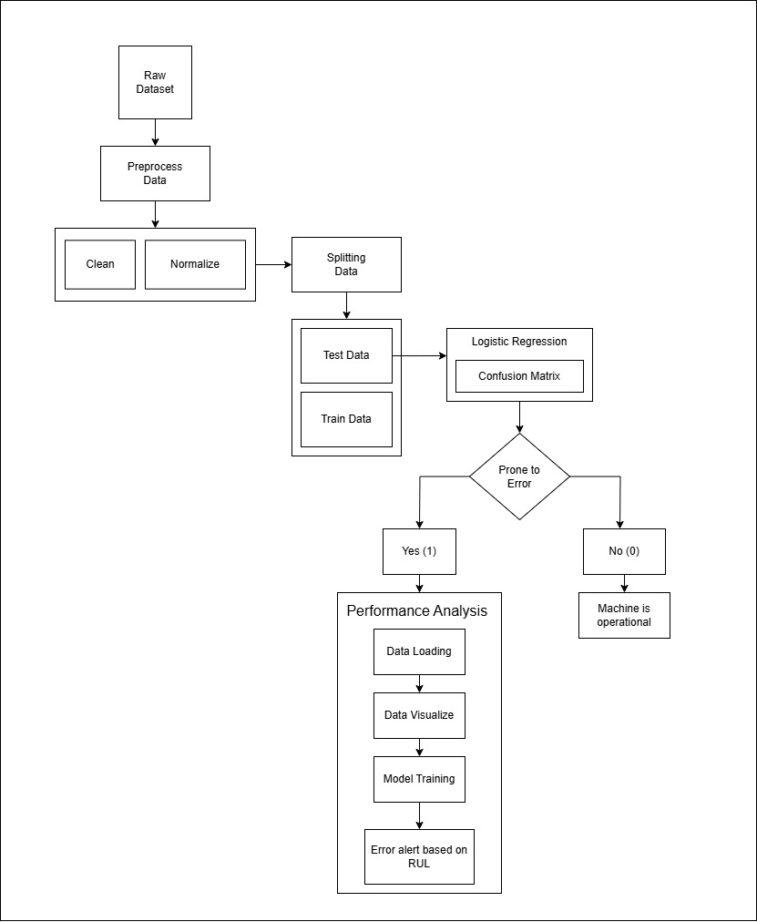
Proposed System Design

Slide 7
Technology Stack for Proposed System
1. Frontend (User Interface)
  HTML5, CSS3, JavaScript
. Backend (Server-Side Logic)
  Node.js
3. Database
  MySQL
4.Data Analytics and Machine Learning
  Python, Pandas, NumPy, Scikit-learn, seaborn

Slide 8
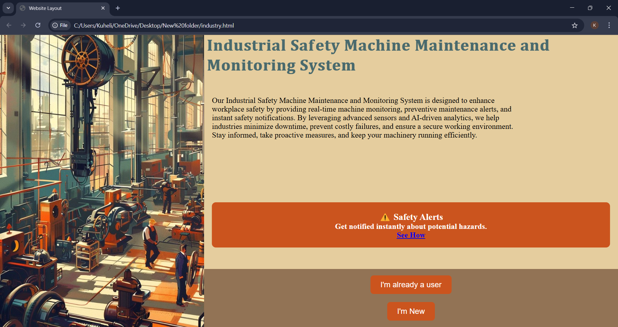
Implementation

Slide 9



Slide 10
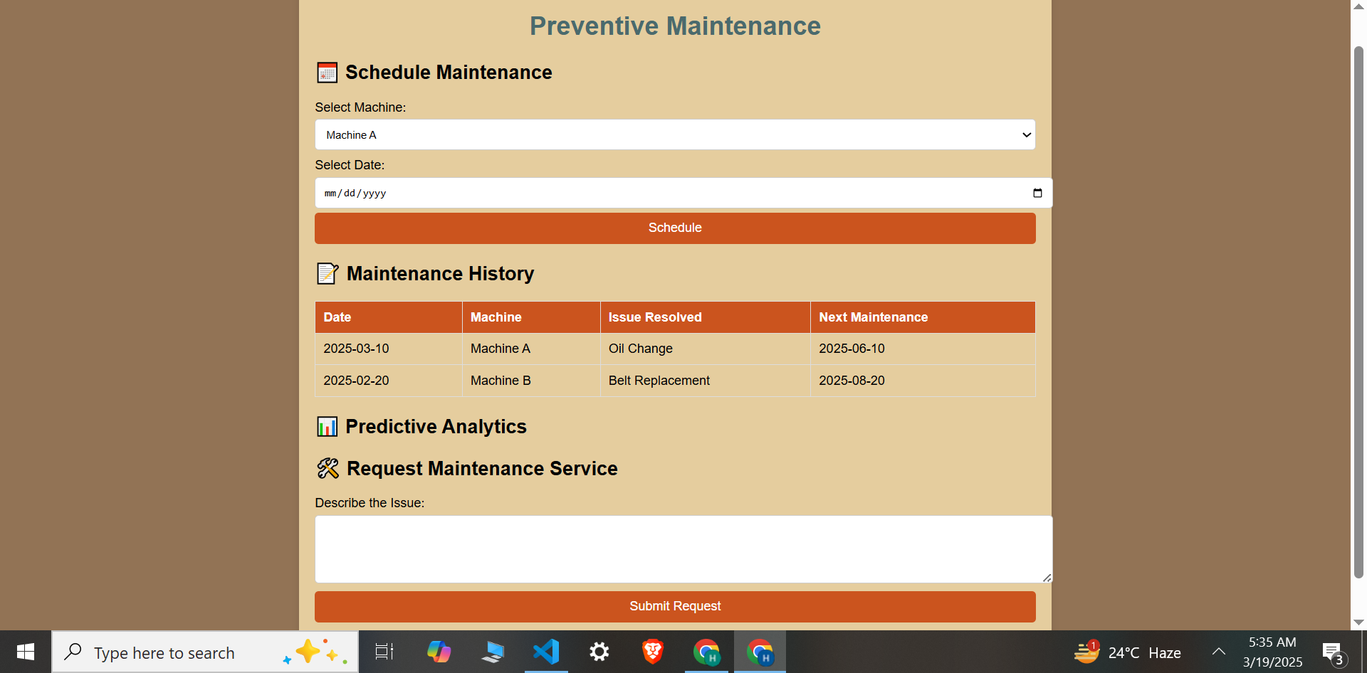
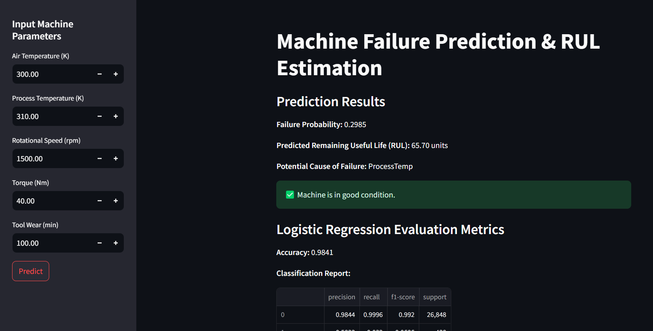

Slide 11
We developed the Industrial Machine Maintenance and Monitoring Hub using logistic regression and random forest regression to analyze sensor data (e.g., air temperature, torque). The logistic model achieved 98.41% accuracy in predicting machine failure, while the random forest estimated RUL (e.g., 1.24 units for 2500 min tool wear). Despite a 0% failure probability, low RUL triggered an urgent maintenance alert, highlighting the model's ability to identify both immediate risks and long-term degradation, ensuring timely interventions and minimizing downtime.
Conclusion

Slide 12
References
[1] T. Wiegand, H. Schwarz, A. Joch, F. Kossentini and G. J. Sullivan, "Rate-constrained coder control and comparison of video coding standards," in IEEE Transactions on Circuits and Systems for Video Technology, vol. 13, no. 7, pp. 688-703, July 2003, doi: 10.1109/TCSVT.2003.815168.
[2] The State of the Art in Research into the Condition Monitoring of Industrial Machinery Alaa Abdul Ȧ School of Mechanical and System Engineering, Available online 01 June 2014, Vol.4, No.3 (June 2014)
[3] W. Zhang, D. Yang and H. Wang, "Data-Driven Methods for Predictive Maintenance of Industrial Equipment: A Survey," in IEEE Systems Journal, vol. 13, no. 3, pp. 2213-2227, Sept. 2019, doi: 10.1109/JSYST.2019.2905565.
[4] T. Roosefert Mohan, J. Preetha Roselyn, R. Annie Uthra, D. Devaraj, K. Umachandran,Intelligent machine learning based total productive maintenance approach for achieving zero downtime in industrial machinery,Computers & Industrial Engineering,Volume 157,2021,107267,ISSN 0360-8352.
[5] Rosmaini Ahmad, Shahrul Kamaruddin,An overview of time-based and condition-based maintenance in industrial application,Computers & Industrial Engineering,Volume 63, Issue 1,2012,Pages 135-149,ISSN 0360-8352.

Slide 13
THANKYOU

